Slide 1
Programming with MySQL
Day 6

Slide 2
PHP Arrays
An array stores multiple values in one single variable.
In PHP, the array() function is used to create an array.
Example:
<?php $cars = array("Volvo", "BMW", "Toyota"); echo "I like " . $cars[0] . ", " . $cars[1] . " and " . $cars[2] . ".";
?>
Three types of arrays:
Indexed arrays - Arrays with a numeric index
Associative arrays - Arrays with named keys
Multidimensional arrays - Arrays containing one or more arrays
The count() function is used to return the length (the number of elements) of an array:
<?php $cars = array("Volvo", "BMW", "Toyota"); echo "I like " . count($cars)[0] . " car brands.";
?>
http://www.w3schools.com/php/php_arrays.asp

Slide 3
Looping through the Arrays
<?php $cars = array("Volvo", "BMW", "Toyota");
$alength = count($cars); for($x = 0; $x < $alength; $x++) { echo $cars[$x]; echo "<br>"; }
?>
What output will this code generate?
http://www.w3schools.com/php/php_arrays.asp

Slide 4
Associative Arrays
Associative arrays are arrays that use named keys that you assign to them.
There are two ways to create an associative array:
<?php $age = array("Peter"=>"35", "Ben"=>"37", "Joe"=>"43"); ?>
Or
<?php
$age['Peter'] = "35"; $age['Ben'] = "37"; $age['Joe'] = "43";
?>
<?php
// foreach loop can be used to loop through an assoc. array foreach($age as $x => $x_value) { echo “Name is " . $x . ", Age is " . $x_value; echo "<br>"; }
?>
http://www.w3schools.com/php/php_arrays.asp

Slide 5
Adding and Removing Elements from the Beginning of an Array
The array_shift() function removes the first element from the beginning of an array
Pass the name of the array whose first element you want to remove
The array_unshift() function adds one or more elements to the beginning of an array
Pass the name of an array followed by comma-separated values for each element you want to add
What will the code on the right output?
<?php $q = array("orange", "banana"); array_unshift($q, "apple", “pear"); print_r($queue);
?>
Notes:
Array ( [0] => apple [1] => raspberry [2] => orange [3] => banana )

Slide 6
Adding and Removing Elements from the Beginning of an Array
$TopSellers = array(
"Chevrolet Impala",
"Chevrolet Malibu",
"Chevrolet Silverado",
"Ford F-Series",
"Toyota Camry",
"Toyota Corolla",
"Nissan Altima",
"Honda Accord",
"Honda Civic",
"Dodge Ram");
array_shift($TopSellers);
array_unshift($TopSellers, "Honda CR-V");
echo "<pre>\n";
print_r($TopSellers);
echo "</pre>\n";

Slide 7
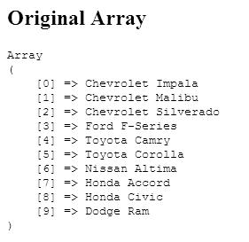
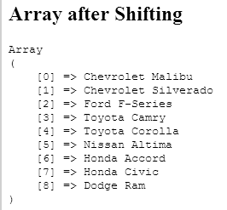
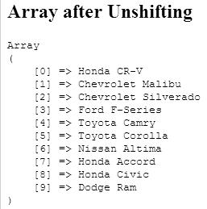
Adding and Removing Elements from the Beginning of an Array
Figure 6-3 Output of an array modified with the array_shift() and array_unshift() functions

Slide 8
Adding and Removing Elements from the End of an Array
The array_pop() function removes the last element from the end of an array
Pass the name of the array whose last element you want to remove
The array_push() function adds one or more elements to the end of an array
Pass the name of an array followed by comma-separated values for each element you want to add

Slide 9
Adding and Removing Elements from the End of an Array
$HospitalDepts = array(
"Anesthesia",
"Molecular Biology",
"Neurology",
"Pediatrics");
array_pop($HospitalDepts); // Removes "Pediatrics"
array_push($HospitalDepts, "Psychiatry", "Pulmonary Diseases");

Slide 10
Adding and Removing Elements Within an Array
The array_splice() function adds or removes array elements
The array_splice() function renumbers the indexes in the array
The syntax for the array_splice() function is:
array_splice(array_name, start, characters_to_delete, values_to_insert);

Slide 11
Adding and Removing Elements Within an Array
To add an element within an array, include a value of 0 as the third argument of the array_splice() function
$HospitalDepts = array(
"Anesthesia", // first element (0)
"Molecular Biology", // second element (1)
"Neurology", // third element (2)
"Pediatrics"); // fourth element (3)
array_splice($HospitalDepts, 3, 0, "Ophthalmology");

Slide 12
Adding and Removing Elements Within an Array
To add more than one element within an array, pass the array() construct as the fourth argument of the array_splice() function
Separate the new element values by commas
$HospitalDepts = array(
"Anesthesia", // first element (0)
"Molecular Biology", // second element (1)
"Neurology", // third element (2)
"Pediatrics"); // fourth element (3)
array_splice($HospitalDepts, 3, 0, array("Opthalmology",
"Otolaryngology"));

Slide 13
Adding and Removing Elements Within an Array
Delete array elements by omitting the fourth argument from the array_splice() function
$HospitalDepts = array(
"Anesthesia", // first element (0)
"Molecular Biology", // second element (1)
"Neurology", // third element (2)
"Pediatrics"); // fourth element (3)
array_splice($HospitalDepts, 1, 2);

Slide 14
Adding and Removing Elements Within an Array
The unset() function removes array elements and other variables
Pass to the unset() function the array name and index number of the element you want to remove
To remove multiple elements, separate each index name and element number with commas
unset($HospitalDepts[1], $HospitalDepts[2]);

Slide 15
Removing Duplicate Elements
The array_unique() function removes duplicate elements from an array
Pass to the array_unique() function the name of the array from which you want to remove duplicate elements
The array_values() and array_unique() functions do not operate directly on an array
The array_unique() function does renumber the indexes after removing duplicate values in an array

Slide 16
Removing Duplicate Elements
$TopSellers = array(
"Ford F-Series", "Chevrolet Silverado", "Toyota Camry",
"Honda Accord", "Toyota Corolla", "Ford F-Series", "Honda Civic",
"Honda CR-V", "Honda Accord", "Nissan Altima", "Toyota Camry",
"Chevrolet Impala", "Dodge Ram", "Honda CR-V");
echo "<p>The 2008 top selling vehicles are:</p><p>";
$TopSellers = array_unique($TopSellers);
$TopSellers = array_values($TopSellers);
for ($i=0; $i<count($ TopSellers); ++$i) {
echo "{$TopSellers[$i]}<br />";
}
echo "</p>";

Slide 17
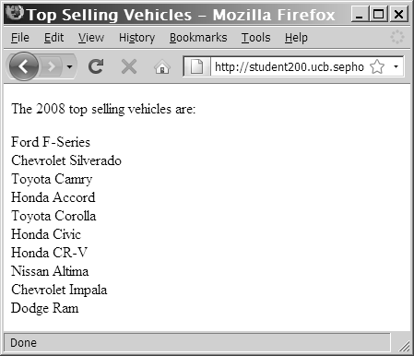
Removing Duplicate Elements
Figure 6-4 Output of an array after removing duplicate values
with the array_unique() function

Slide 18
Finding and Extracting Elements and Values
One of the most basic methods for finding a value in an array is to use a looping statement to iterate through the array until you find the value
Rather than write custom code to find a value, use the in_array() and array_search() functions to determine whether a value exists in an array

Slide 19
Determining if a Value Exists
The in_array() function returns a Boolean value of true if a given value exists in an array
The array_search() function determines whether a given value exists in an array and:
Returns the index or key of the first matching element if the value exists, or
Returns FALSE if the value does not exist
if (in_array("Neurology", $HospitalDepts))
echo "<p>The hospital has a Neurology department.</p>";

Slide 20
Determining if a Key Exists
The array_key_exists() function determines whether a given index or key exists
You pass two arguments to the array_key_exists() function:
The first argument represents the key to search for
The second argument represents the name of the array in which to search

Slide 21
Determining if a Key Exists
$ScreenNames["Dancer"] = "Daryl";
$ScreenNames["Fat Man"] = "Dennis";
$ScreenNames["Assassin"] = "Jennifer";
if (array_key_exists("Fat Man", $ScreenNames))
echo "<p>{$ScreenNames['Fat Man']} is already
'Fat Man'.</p>\n";
else {
$ScreenNames["Fat Man"] = "Don";
echo "<p>{$ScreenNames['Fat Man']} is now
'Fat Man'.</p>";
}

Slide 22
Returning a Portion of an Array
The array_slice() function returns a portion of an array and assigns it to another array
The syntax for the array_slice() function is:
array_slice(array_name, start, characters_to_return);

Slide 23
Returning a Portion of an Array
// This array is ordered by sales, high to low.
$TopSellers = array("Ford F-Series", "Chevrolet Silverado", "Toyota Camry", "Honda Accord", "Toyota Corolla", "Honda Civic", "Nissan Altima", "Chevrolet Impala", "Dodge Ram", "Honda CR-V");
$FiveTopSellers = array_slice($TopSellers, 0, 5);
echo "<p>The five best-selling vehicles for 2008 are:</p>\n";
for ($i=0; $i<count($FiveTopSellers); ++$i) {
echo "{$FiveTopSellers[$i]}<br />\n";
}

Slide 24
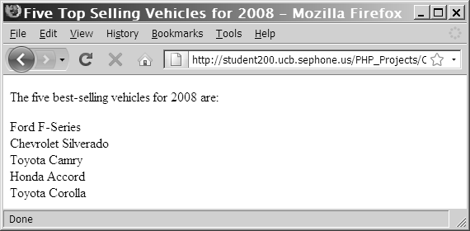
Returning a Portion of an Array
Figure 6-11 Output of an array returned with the array_slice() function

Slide 25
Sorting Arrays
The most commonly used array sorting functions are:
sort() and rsort() for indexed arrays
ksort() and krsort() for associative arrays

Slide 26
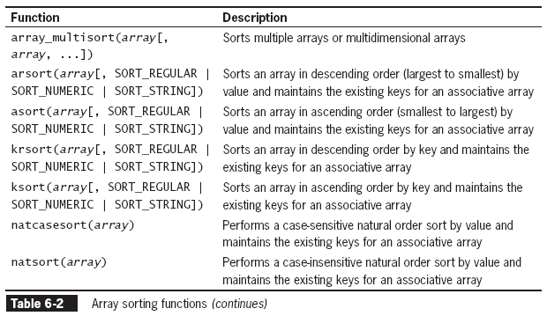
Sorting Arrays

Slide 27
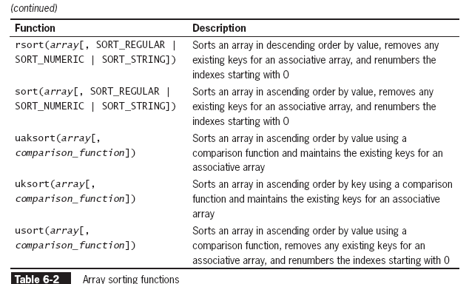
Sorting Arrays

Slide 28
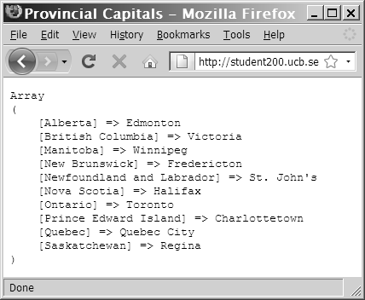
Sorting Arrays
Figure 6-15 Output of an associative array
after sorting with the ksort() function

Slide 29
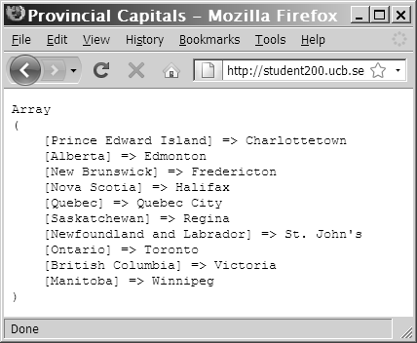
Sorting Arrays
Figure 6-14 Output of an associative array after sorting
with the asort() function

Slide 30
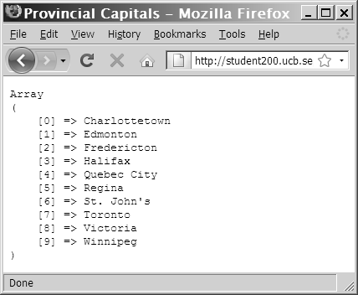
Sorting Arrays
Figure 6-13 Output of an associative array after sorting with the sort() function

Slide 31
Exercise
Use the guest book exercise from the previous class (Day 5), add the sorting functionality by guest name.

Slide 32
Combining Arrays
To append one array to another, use the addition (+) or the compound assignment operator (+=)
To merge two or more arrays use the array_merge() function
The syntax for the array_merge() function is:
new_array = array_merge($array1, $array2, $array3, ...);

Slide 33
Combining Arrays
$Provinces = array("Newfoundland and Labrador", "Prince Edward Island", "Nova Scotia", "New Brunswick", "Quebec", "Ontario", "Manitoba", "Saskatchewan", "Alberta", "British Columbia");
$Territories = array("Nunavut", "Northwest Territories", "Yukon Territory");
$Canada = $Provinces + $Territories;
echo "<pre>\n";
print_r($Canada);
echo "</pre>\n";

Slide 34
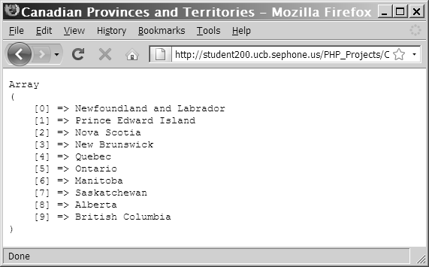
Combining Arrays
Figure 6-12 Output of two indexed arrays combined with the addition operator

Slide 35
Comparing Arrays
The array_diff() function returns an array of elements that exist in one array but not in any other arrays to which it is compared
The syntax for the array_diff() function is:
new_array = array_diff($array1, $array2, $array3, ...);
The array_intersect() function returns an array of elements that exist in all of the arrays that are compared
The syntax for the array_intersect() function is:
new_array = array_intersect($array1, $array2, $array3, ...);

Slide 36
Creating Two-Dimensional Indexed Arrays
A multidimensional array consists of multiple indexes or keys
A two-dimensional array has two sets of indexes or keys

Slide 37
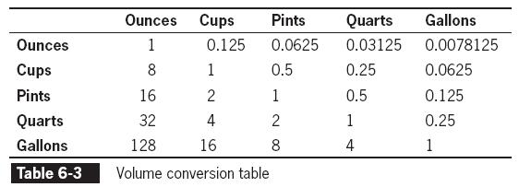
Creating Two-Dimensional Indexed Arrays (continued)
$Gallons = array(
128, // ounces
16, // cups
8, // pints
4 // quarts
);

Slide 38
Creating Two-Dimensional Indexed Arrays
$Ounces = array(1, 0.125, 0.0625, 0.03125, 0.0078125);
$Cups = array(8, 1, 0.5, 0.25, 0.0625);
$Pints = array(16, 2, 1, 0.5, 0.125);
$Quarts = array(32, 4, 2, 1, 0.25);
$Gallons = array(128, 16, 8, 4, 1);

Slide 39
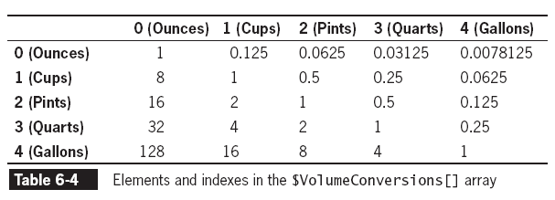
Creating Two-Dimensional Indexed Arrays
$VolumeConversions = array($Ounces, $Cups, $Pints, $Quarts, $Gallons);

Slide 40
Creating Two-Dimensional Associative Arrays
$Ounces = array("ounces" => 1, "cups" => 0.125, "pints" => 0.0625, "quarts" => 0.03125, "gallons" => 0.0078125);
$Cups = array("ounces" => 8, "cups" => 1, "pints" =>0.5, "quarts" => 0.25, "gallons" => 0.0625);
$Pints = array("ounces" => 16, "cups" => 2, "pints" =>1, "quarts" => 0.5, "gallons" => 0.125);
$Quarts = array("ounces" => 32, "cups" => 4, "pints" =>2, "quarts" => 1, "gallons" => 0.25);
$Gallons = array("ounces" => 128, "cups" => 16, "pints" =>8, "quarts" => 4, "gallons" => 1);

Slide 41
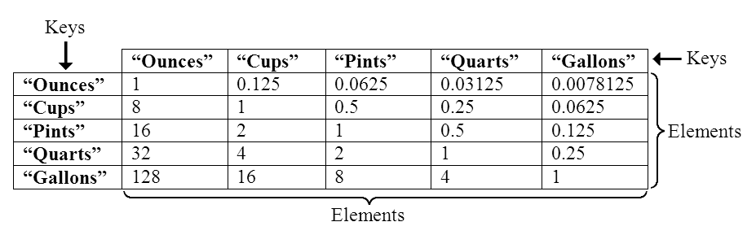
Creating Two-Dimensional Associative Arrays
Figure 6-21 Elements and keys in the
$VolumeConversions[ ] array

Slide 42
Creating Multidimensional Arrays with a Single Statement
$VolumeConversions = array(
array(1, 0.125, 0.0625, 0.03125, 0.0078125), // Ounces
array(8, 1, 0.5, 0.25, 0.0625), // Cups
array(16, 2, 1, 0.5, 0.125), // Pints
array(32, 4, 2, 1, 0.25), // Quarts
array(128, 16, 8, 4, 1) // Gallons
);

Slide 43
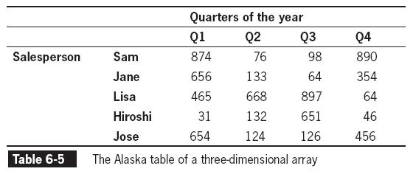
Working with Additional Dimensions

Slide 44
Using Arrays in Web Forms
Store form data in an array by appending an opening and closing ([]) to the value of the name attribute
Data from any element with the same value for the name attribute will be appended to an array with that name
<form method='post' action='ProcessForm.php'>
<p>Enter the first answer:
<input type='text' name='answers[]' /></p>
<p>Enter the second answer:
<input type='text' name='answers[]' /></p>
<p>Enter the third answer:
<input type='text' name='answers[]' /></p>
<input type='submit' name='submit' value='submit' />
</form>

Slide 45
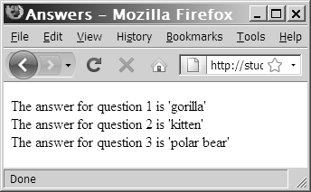
Using Arrays in Web Forms
if (is_array($_POST['answers')) {
$Index = 0;
foreach ($_POST['answers'] as $Answer) {
++$Index;
echo "The answer for question $Index is '$Answer'<br />\n";
}
}
Figure 6-22 Output of an array posted from a Web form

Slide 46
Creating an Associative Forms Array
<form method='post' action='ProcessForm.php'>
<p>Enter the first answer:
<input type='text' name='answers[Question 1]' /></p>
<p>Enter the second answer:
<input type='text' name='answers[Question 2]' /></p>
<p>Enter the third answer:
<input type='text' name='answers[Question 3]' /></p>
<input type='submit' name='submit' value='submit' />
</form>

Slide 47
Summary
The array_shift() function removes the first element from the beginning of an array
The array_unshift() function adds one or more elements to the beginning of an array
The array_pop() function removes the last element from the end of an array
The array_push() function adds one or more elements to the end of an array
The array_splice() function adds or removes array elements

Slide 48
Summary
The unset() function removes array elements and other variables
The array_values() function renumbers an indexed array’s elements
The array_unique() function removes duplicate elements from an array
The in_array() function returns a Boolean value of TRUE if a given value exists in an array
The array_search() function determines whether a given value exists in an array

Slide 49
Summary
The array_key_exists() function determines whether a given index or key exists
The array_slice() function returns a portion of an array and assigns it to another array
The array_merge() function merges two or more arrays
The array_diff() function returns an array of elements that exist in one array but not in any other arrays to which it is compared

Slide 50
Summary
The array_intersect() function returns an array of elements that exist in all of the arrays that are compared
A multidimensional array consists of multiple sets of indexes or keys
A two-dimensional array has two sets of indexes or keys
When array notation is used in the name of a Web form input, the value gets stored in a nested array within the $_POST or $_GET array

Slide 51
Exercise
Create an online order form as a Web form. Allow visitors to enter a quantity for at least five items for sale. Each item should have a name, description and price. The form should have buttons to update the totals for the quantities entered and to submit the order. Save the orders to a subdirectory called OnlineOrders. Use the date and time to create a unique filename for each order
Read the PHP date() function documentation at http://php.net/manual/en/function.date.php

